Slide 1

The Aetiology of Pressure Ulcers, their management and treatment
Michelle Greenwood
www.shelden-healthcare.co.uk

Slide 2
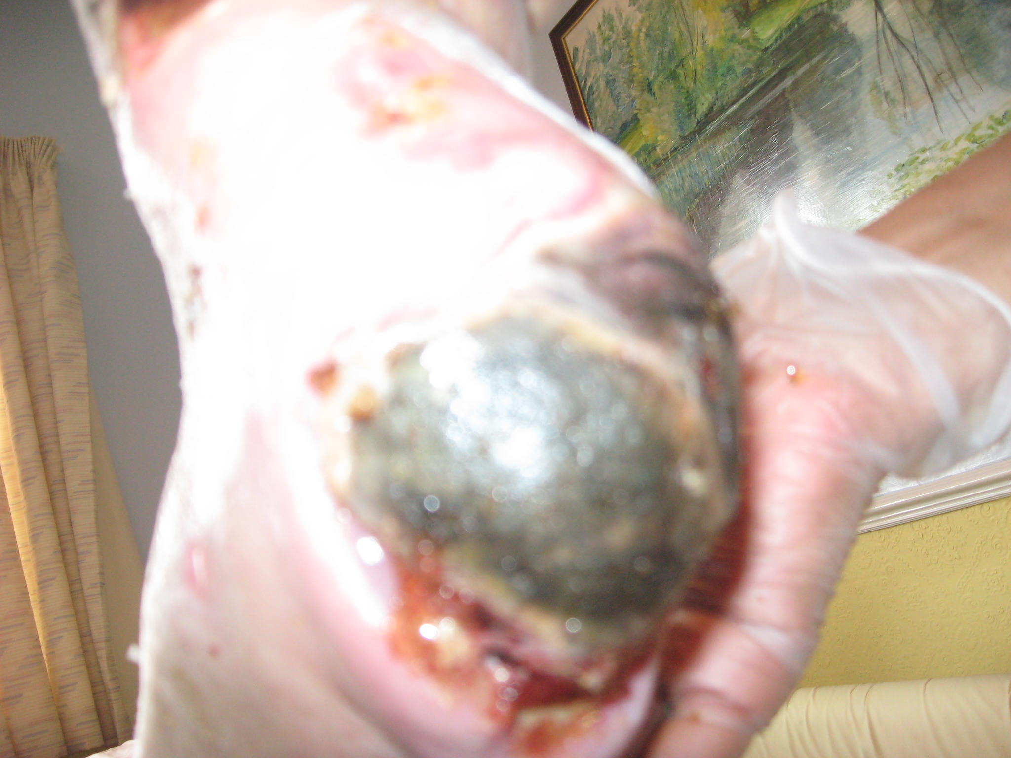
How many of you have seen a wound like this before?

Slide 3
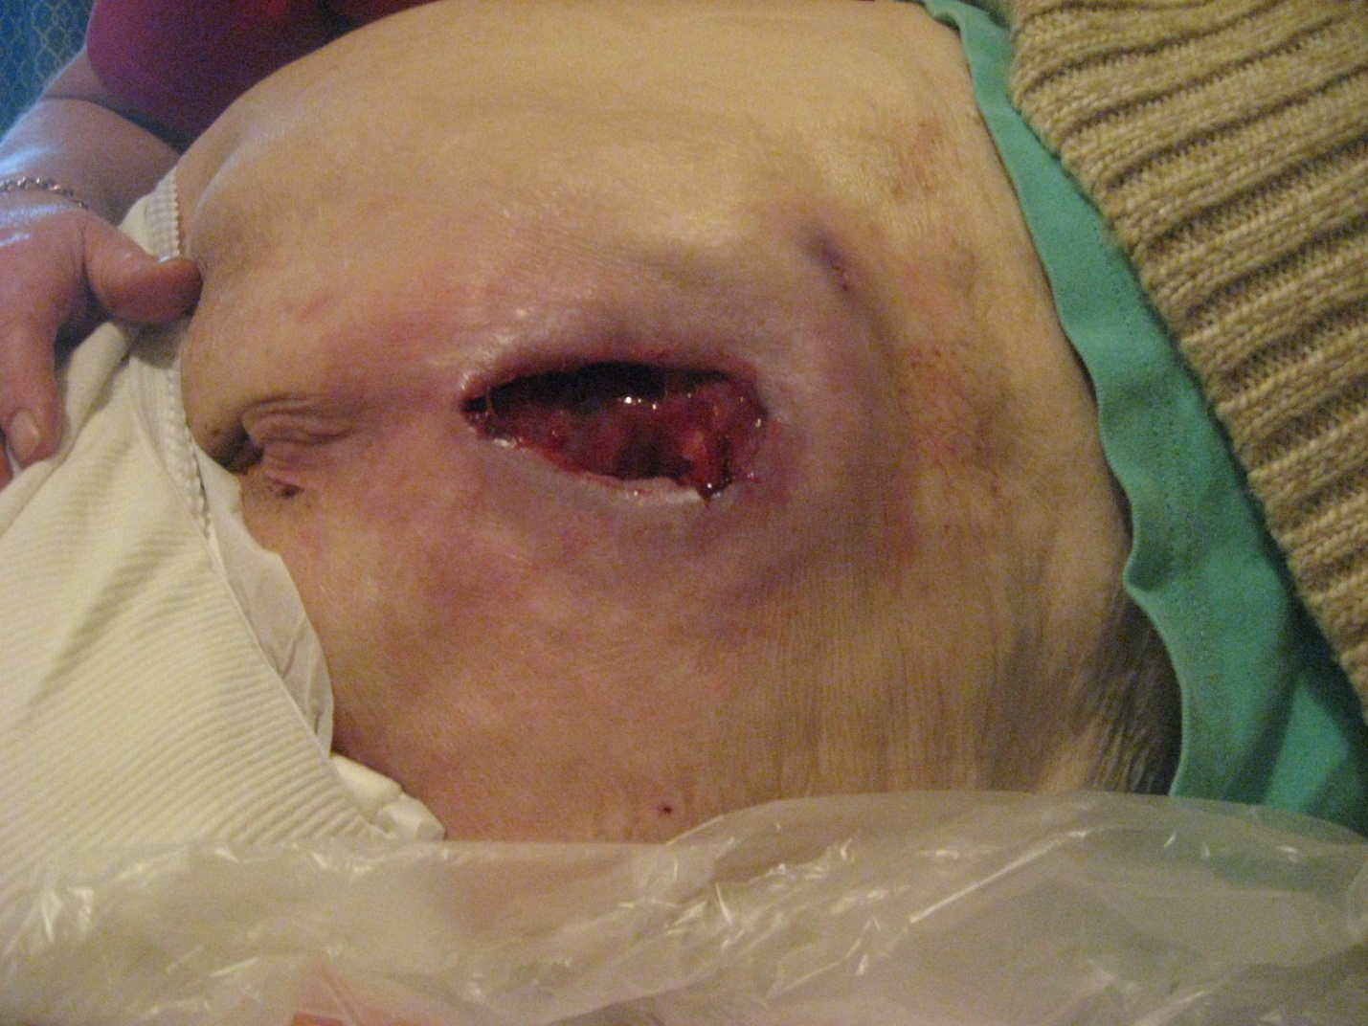
Or this?

Slide 4
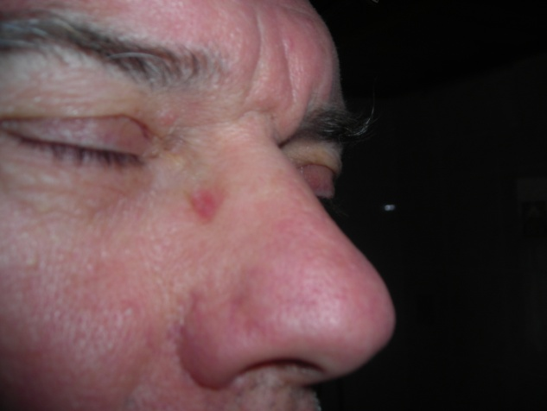
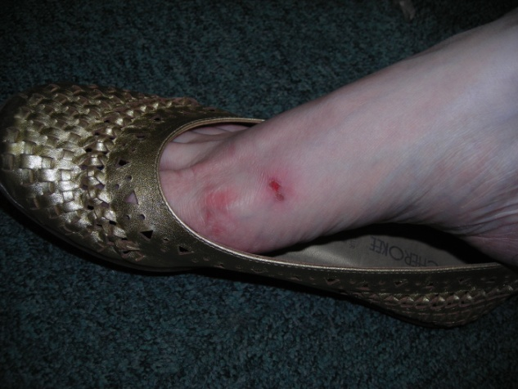
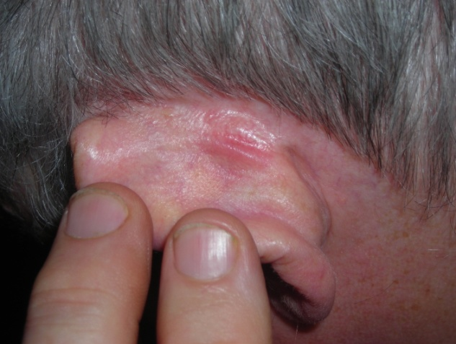
Or this?

Slide 5
What is it like to have a pressure ulcer?

Slide 6
“So much flesh was eaten away, exposing my spine, that it took two plastic surgeons to operate on the area between my buttocks.”

Slide 7
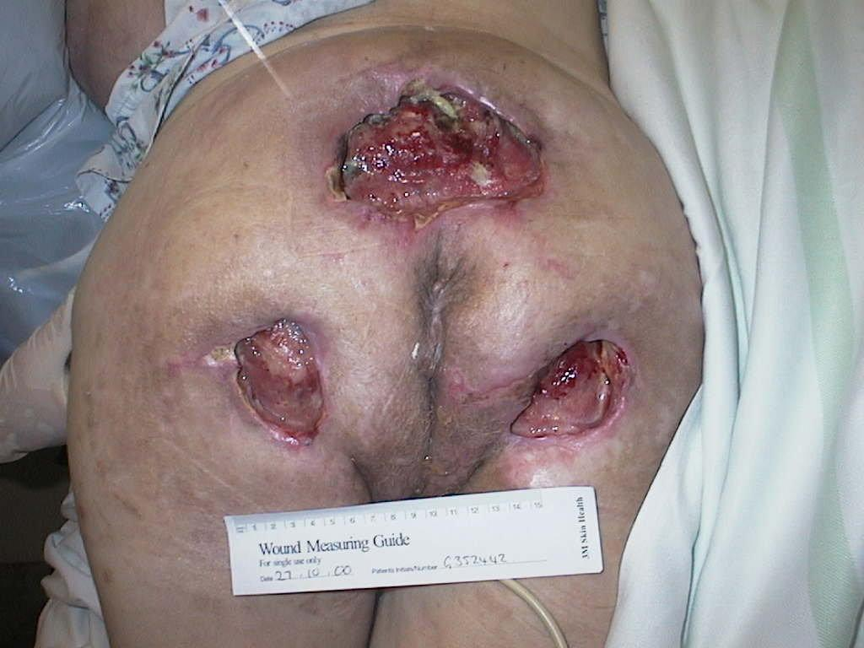
Pressure Ulcers
Painful
Preventable
Debilitating
Complex
Expensive

Slide 8
History
Florence Nightingale maintained that Pressure Ulcers could be prevented by good nursing care
Over time the cause became bad nursing care
Charcot 1879 felt they were an inevitable consequence of spinal injury

Slide 9
History
Bed fast patients were washed and vigorously massaged with soap and water then such potions as powder, oil and spirit or cream rubbed into the skin

Slide 10
Pressure ulcers, pressure sores, decubitus ulcer and bedsores
A pressure ulcer can be defined as:
“A localised area of cellular damage resulting from direct pressure on the skin causing ischaemia, or from shearing or friction causing mechanical stress on the tissues.”
(Chapman & Chapman 1996)

Slide 11
Survey of pressure ulcers.
No national survey has been undertaken.
D.o.H (1993) views that pressure ulcers should be considered as a key indicator of the quality of care provided in any care setting.
European Pressure Ulcer advisory panel (EPUAP) – All category 3 and 4 are reportable
Clinical benchmarking recognises pressure ulcer prevention as the essence of care
Your turn campaign
Government driving to make them a non event

Slide 12
PRESSURE ULCER FIGURES
95% of all pressure ulcers are preventable
Reduction in incidence from 16% to 1.8% has been achieved
50% of patients admitted from the community, residential and nursing homes have pressure ulcers- Richardson 1993
7% incidence in the community (NHS Exec)
At the patients conference in 2010, over 1900 pressure ulcers were reported as the cause of death!!
True figures are still not known

Slide 13
location of pressure ulcers
Trunk 4%
Upper limbs 3%
Sacrum 31%
Trochanters 10%
Buttocks 27%
Lower limbs 5%
Heels 20%
David et al 1983
Notes:
A notable study by David et al in 1983, demonstrated the sites of commonly occurring pressure ulcers and frequency of occurrence. Echoing these distribution patterns, Crow and Clarke in 1990 named heels, sacrum and ischial tuberosities as the most vulnerable sites. Cheneworth et al 1994 found the heels were the second most common site for the development of pressure ulcers after the sacrum. Recent literature reveals that the incidence of pressure ulcers on heels has increased steadily over the past few decades (Collier 2000).
The link between prolonged periods of sitting and tissue damage is also well established (Dealey 1991; Gebhardt and Bliss 1994; Collins 1999.)

Slide 14
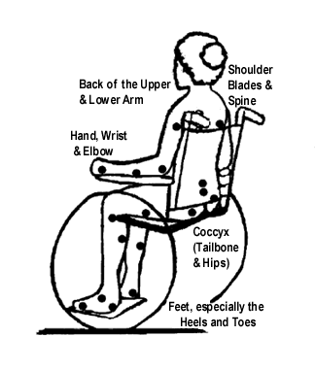

Slide 15
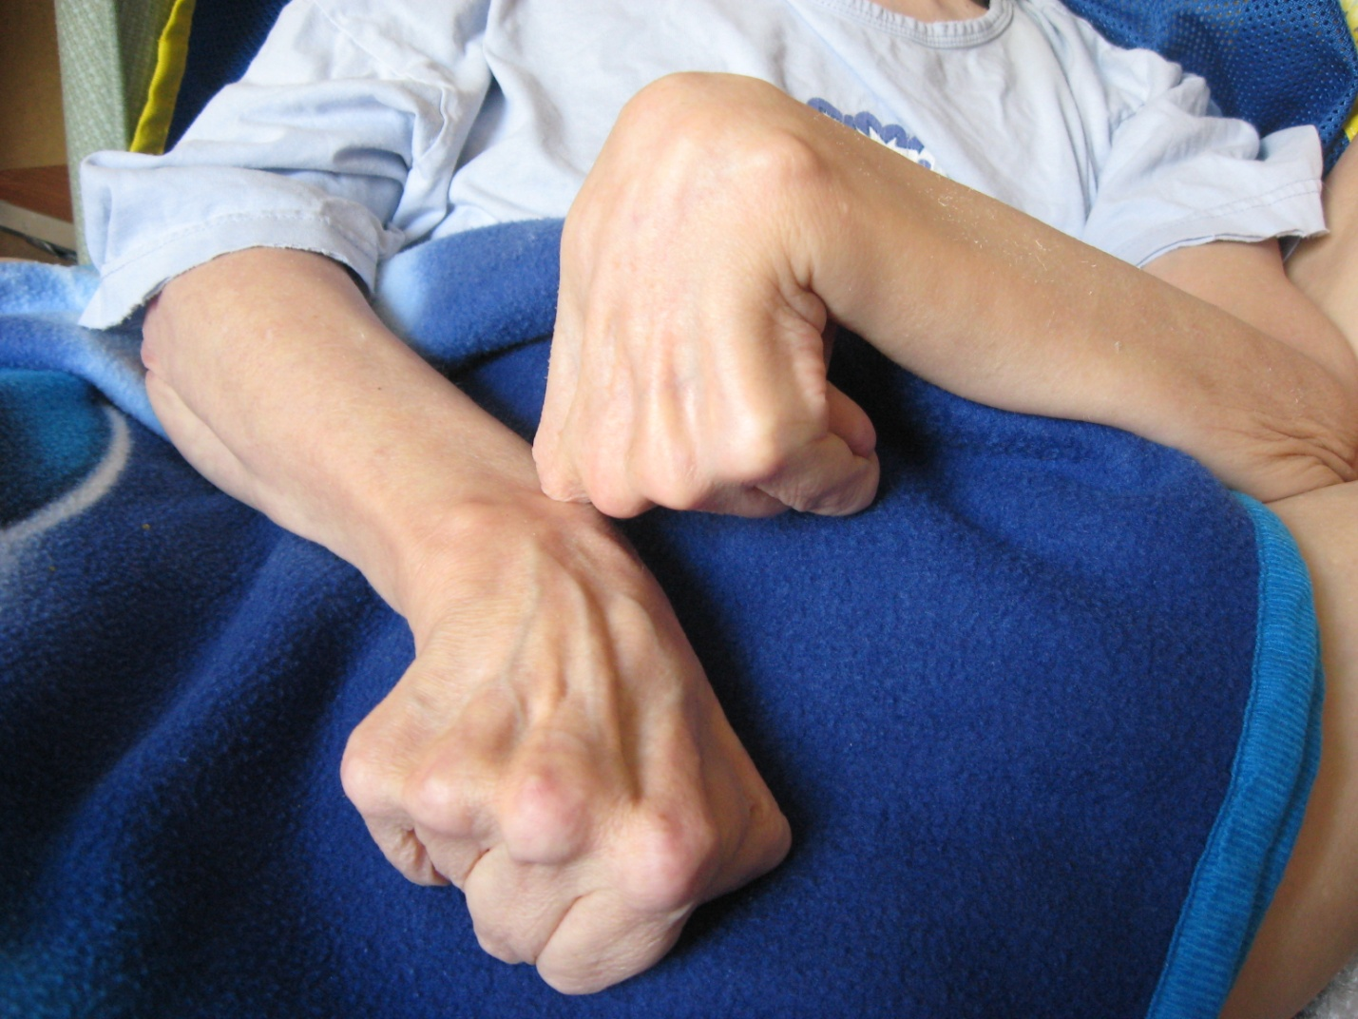

Slide 16
Causes of pressure ulcer development-Internal factors
General health and age
Mobility
Body weight-Impaired nutritional status
Incontinence
Poor blood supply
Sensitivity to pain or discomfort
Medication
Inadequate diet or fluid intake

Slide 17
Causes of pressure ulcer development-External factors
Pressure
Shear
Friction
Moisture

Slide 18
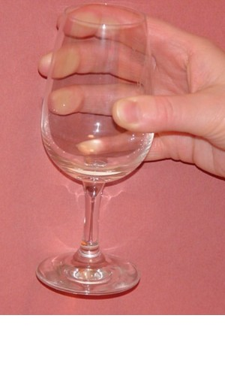
Pressure - Stopping Blood Flow is Easy

Slide 19
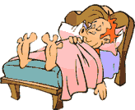
Shear
This occurs were the skeleton moves but the skin stays still
This causes the small blood vessels to tear leading to disruption of the local blood supply
Such as constant sliding down the bed

Slide 20
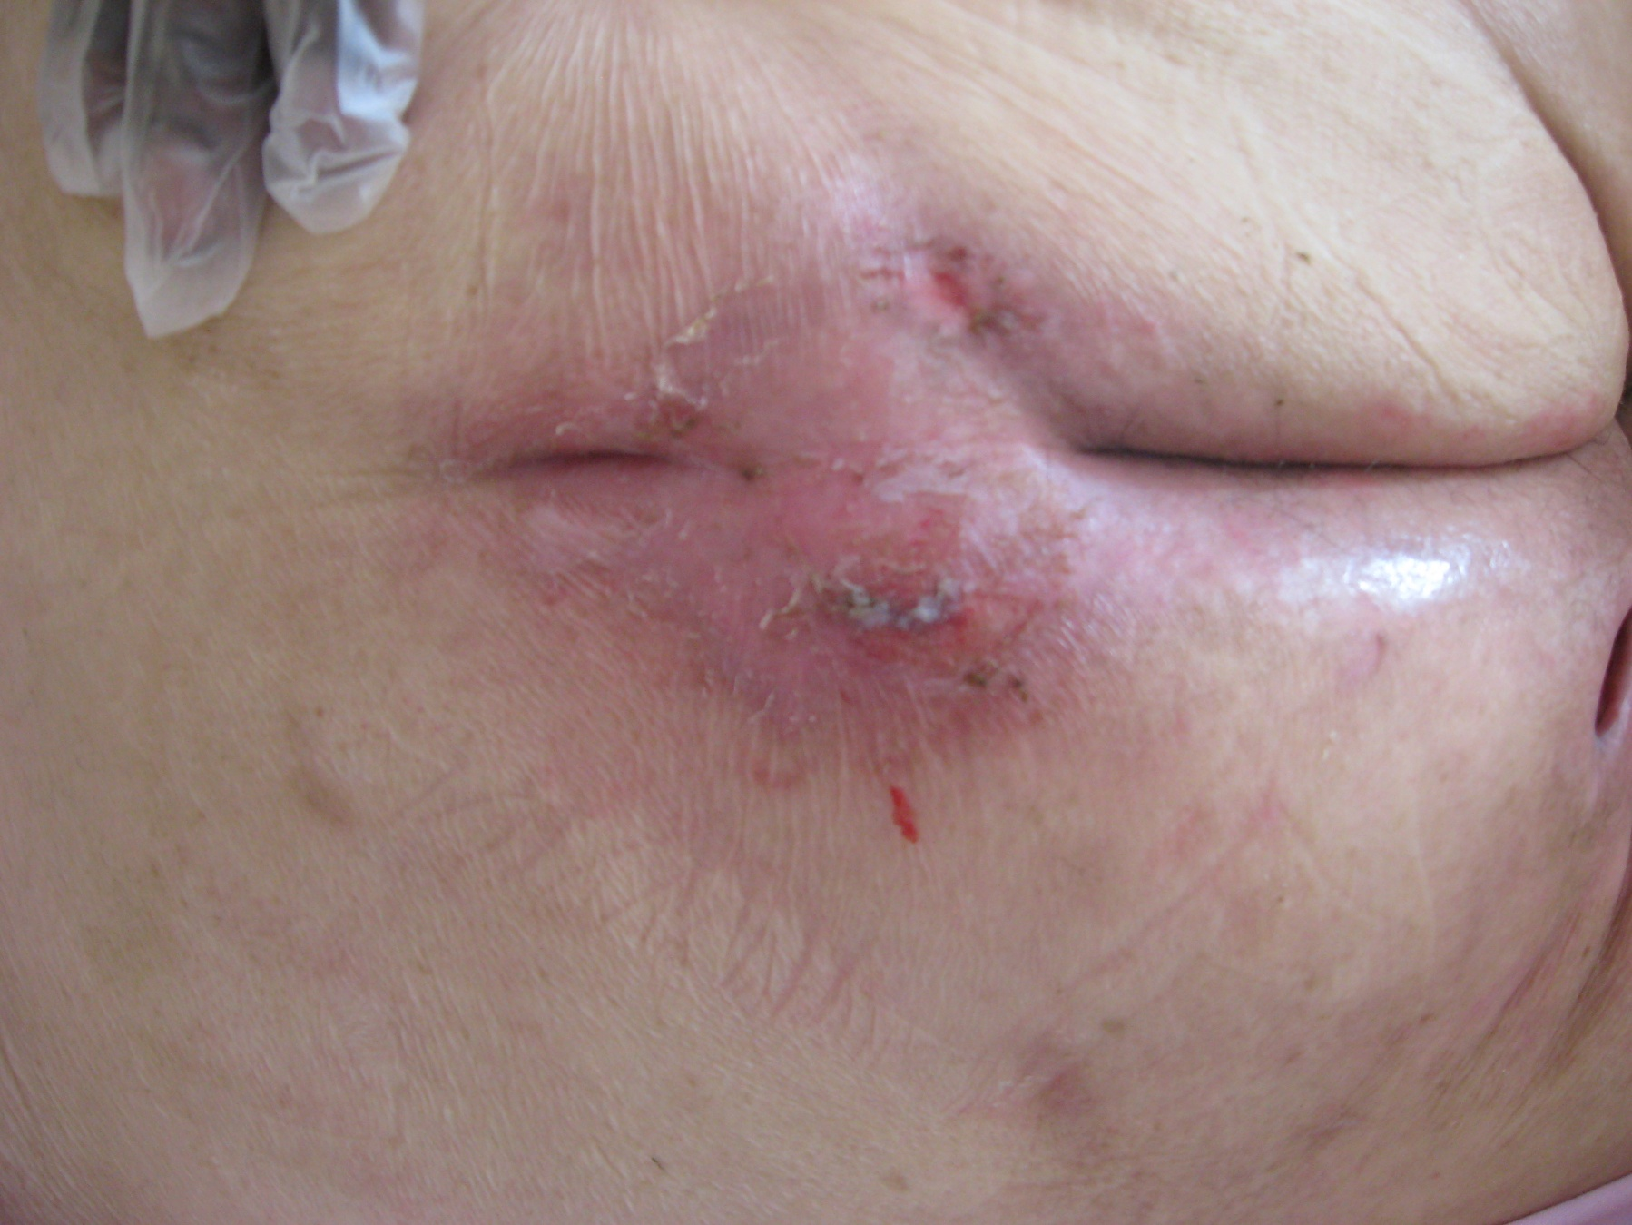

Slide 21
Friction
Force generated when two surfaces move across one another
This results in superficial damage such as stripping of the epidermis
Exacerbated by moisture

Slide 22
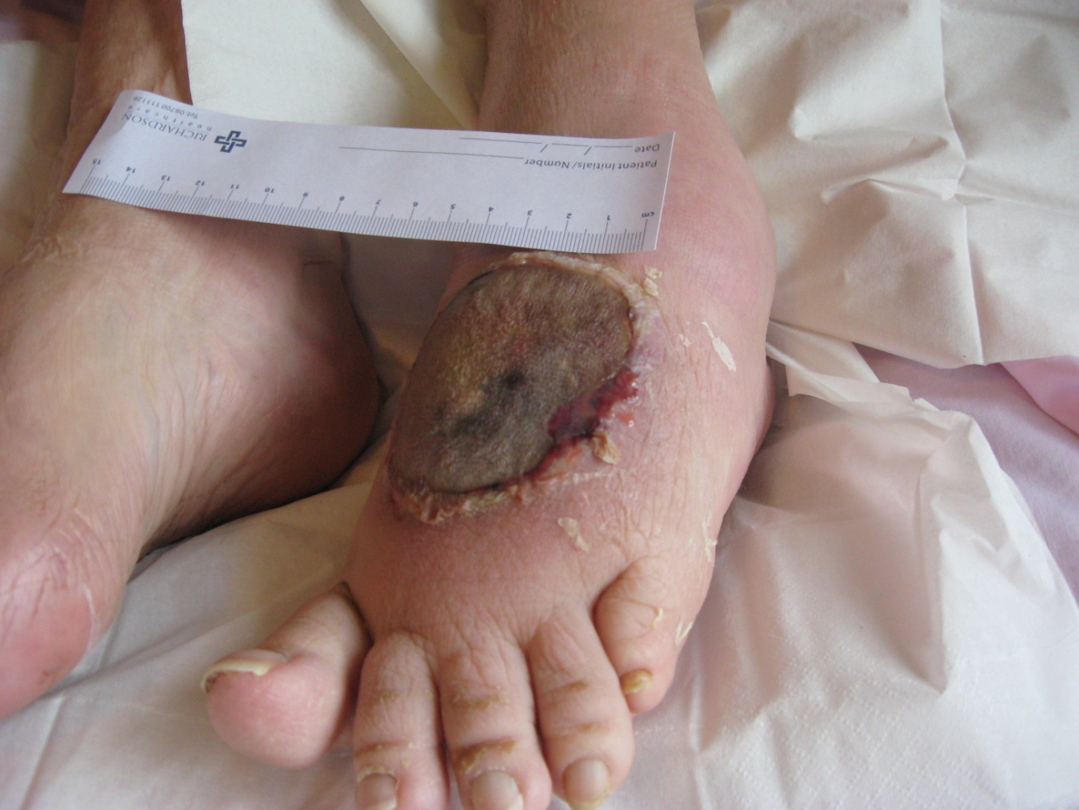

Slide 23
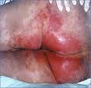

Slide 24
Observing skin
Clients/residents should be encouraged to inspect their own skin.
Purplish/bluish patches on non Caucasian skin.
Red patches on light skinned people
Swelling
Blisters
Shiny areas
Dry patches
Cracks, calluses and wrinkles

Slide 25
Signs to feel for are:
Hard areas
Warm areas
Swollen skin over bony points

Slide 26
Assessment tools
Waterlow is the most widely tool used in the U.K.
Aims to provide a quick, simple and comprehensive method of assessing the risk of a client developing a pressure ulcer.
Provide objective evidence of risk
To place clients in one of three bands of increasing risk to enable appropriate cost effective preventative aids and nursing resources to be allocated
To provide objective evidence of need to management, should extra resources be needed.

Slide 27
Assessment
All formal assessment’s should be undertaken by assessors who have specific knowledge and expertise, have on-going training and regularly use their assessment skills
All formal assessments should be documented and made available to patients/clients carers and the multi-disciplinary team.
Risk assessment tools should only be used as an aide memoire. Must never replace clinical expertise. (Nice 2009)

Slide 28
Differences in darkly pigmented skin
  purplish/bluish localised areas of skin
  localised heat that, if tissue becomes damaged, is replaced by coolness
  localised oedema and localised induration
  Change to skin texture

Slide 29

Your Turn is a national movement campaigning for the mandatory reporting of incidents of pressure ulcers in the UK.
www.your-turn.org.uk

Slide 30
So how do we identify a Pressure ulcer…..
By the level of damage to the skin and the structures that are involved.
Graded using 1-4 category system, where a category 1 is the least level of damage, up to category 4 being the most severe.

Slide 31
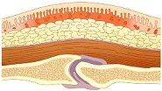
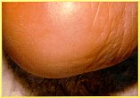
Category 1
Non-blanching erythema of intact skin.
Discolouration of the skin, warmth, oedema, induration or hardness

Slide 32
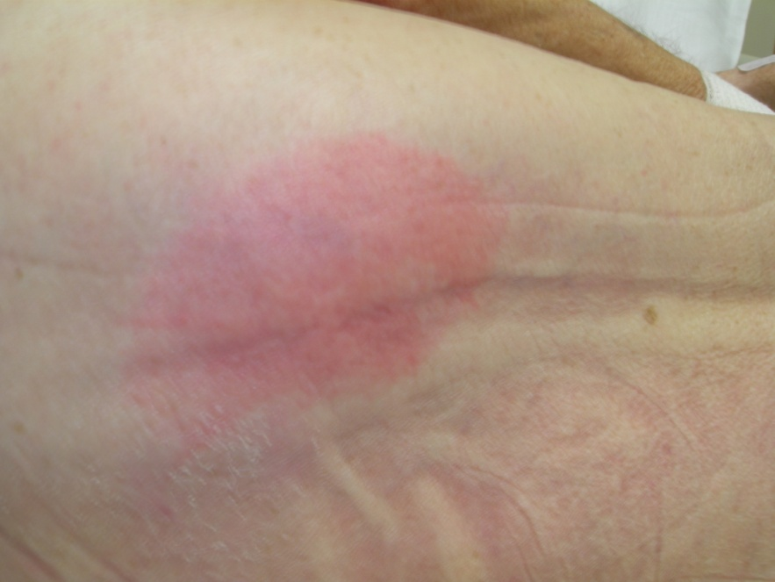

Slide 33
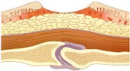
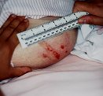
Category 2
Partial thickness skin loss involving epidermis and/or dermis. The ulcer appears superficial and presents clinically as an abrasion or blister.

Slide 34
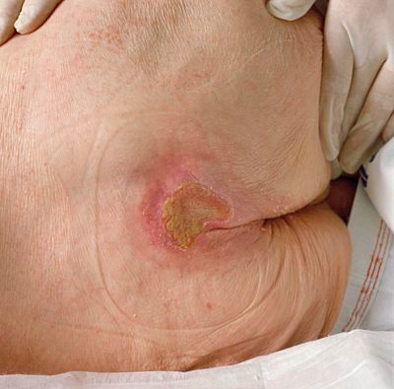

Slide 35

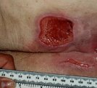
Category 3
Full thickness skin loss involving damage to or necrosis of subcutaneous tissue that may extend down to, but not through underlying fascia

Slide 36
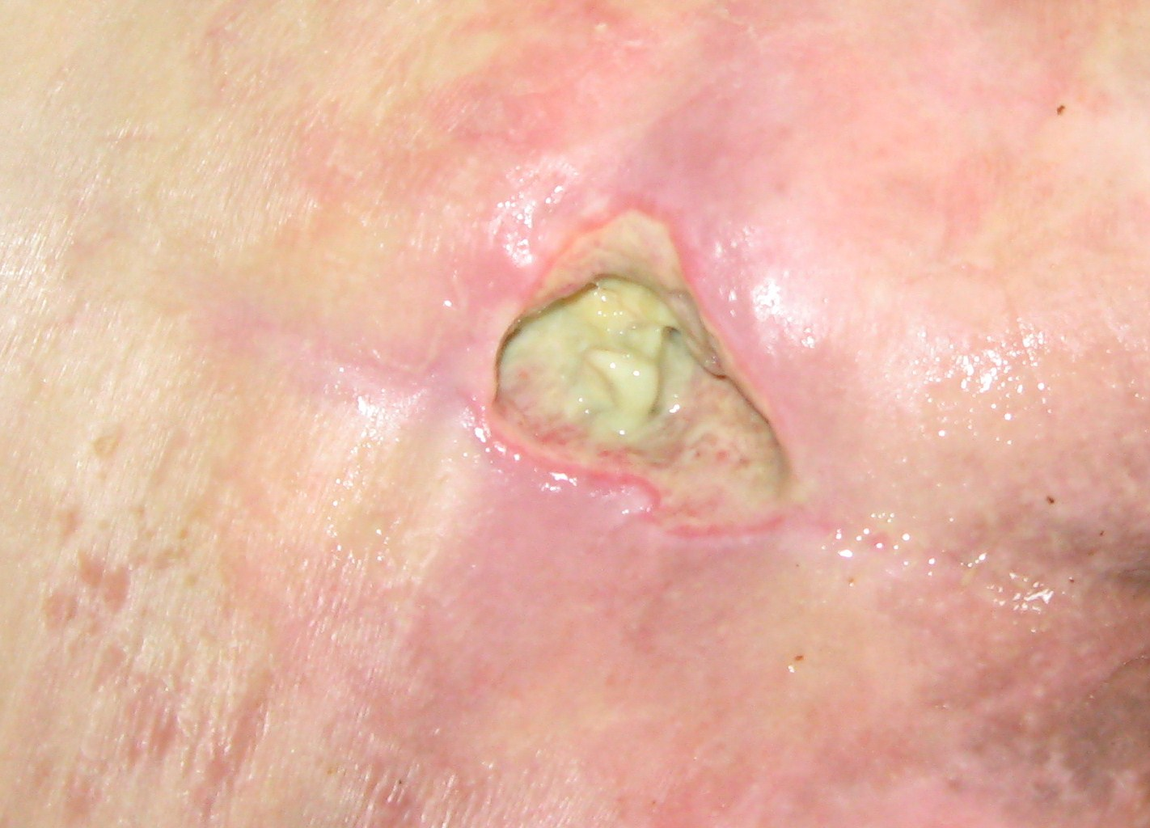

Slide 37

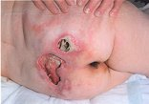
Category 4
Extensive destruction, tissue necrosis, or damage to muscle, bone, or supporting structures with or without full thickness skin loss.

Slide 38
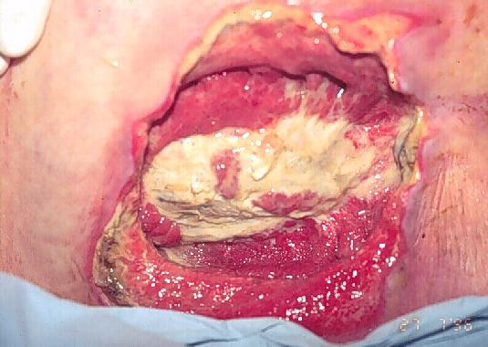

Slide 39
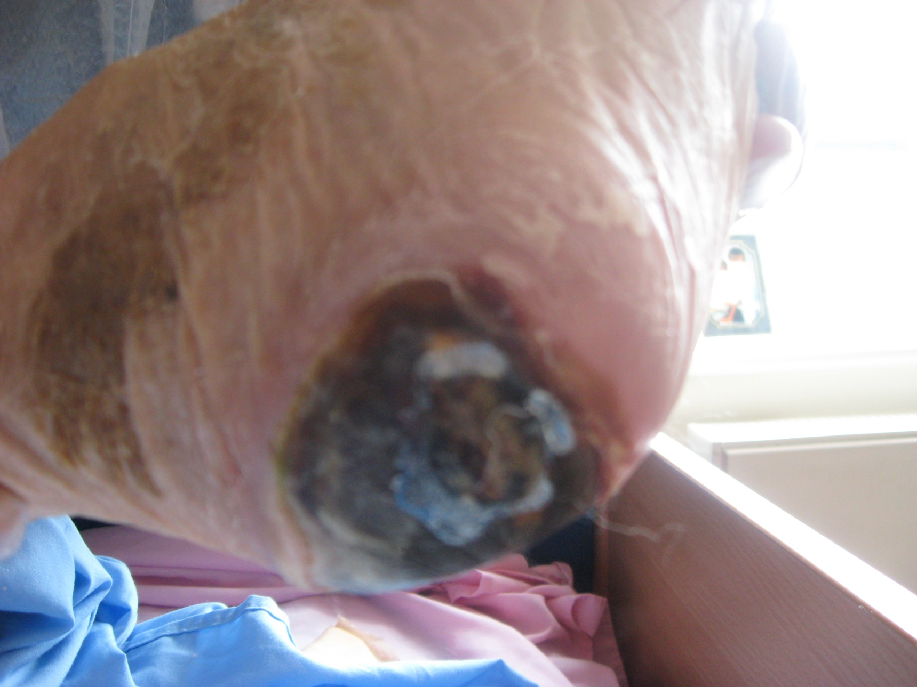

Slide 40
Holistic assessment / accurate diagnosis
Examples
    Relief of pressure
    Reduce shear and friction
    Nutritional status
    Medication
    Increase / maximise vascular inflow
    Glycaemic control
    Control pain
Notes:
Be systematic in your approach to evidence based practice.
Don’t be put off by technology.
Find help to start you on the road to being an informed practitioner.
Be aware of your responsibilities.
Measure your success.

Slide 41
Accountability
You are personally accountable for actions and omissions in your practice and must always be able to justify your decisions.
If you delegate a task you are responsible for ensuring the person has the correct skills to achieve a positive outcome
Your Carers – the eyes and ears of the qualified staff!!

Slide 42
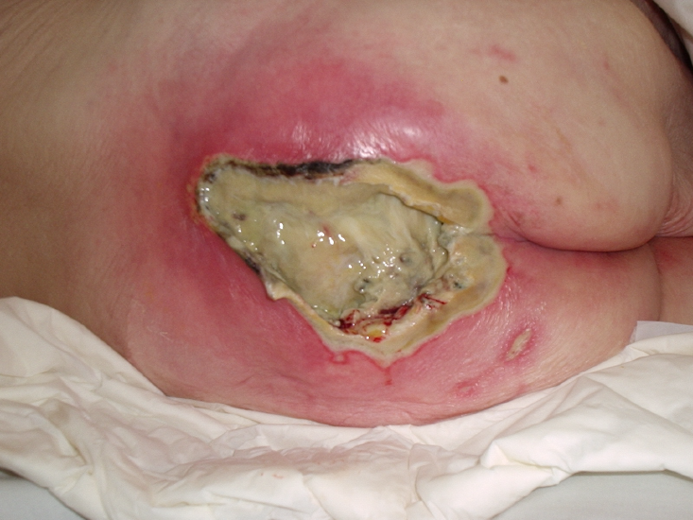
Notes:
Delegate Notes
Elderly female
Own home
Private carers
Off legs
Poor Nutrition / dehydrated
Admitted by GP ? Chest infection on amoxil 250mgs tds
Only other medications (oral anti-inflammatory – osteoarthritis)
Speaker Notes
Target T / I high levels of exudate
Priority debridement and antibiotics to reduce microbial burden, odour control and exudate management
Pressure Relief / reduction

Slide 44
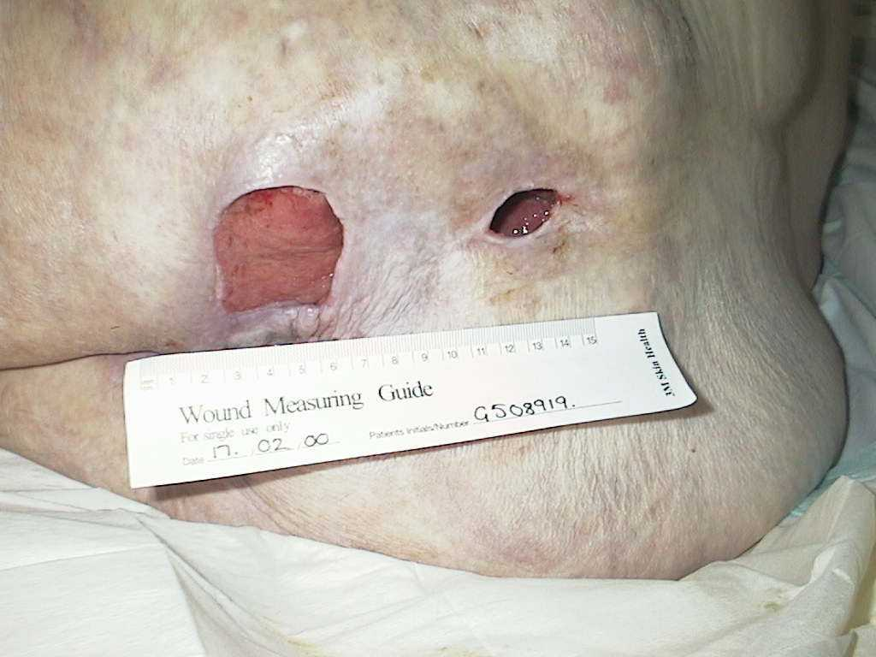

Slide 45
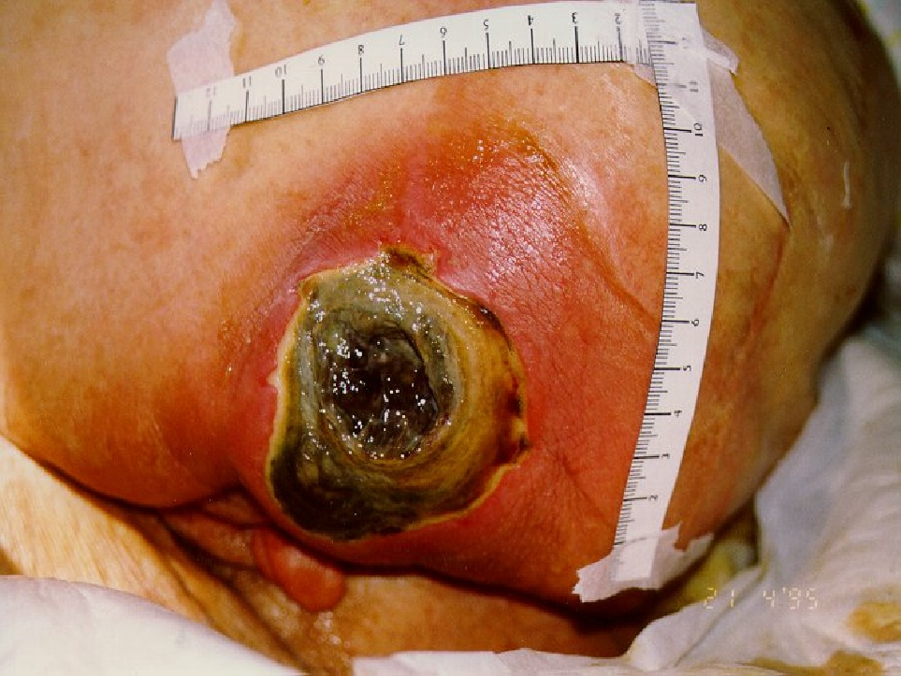

Slide 46
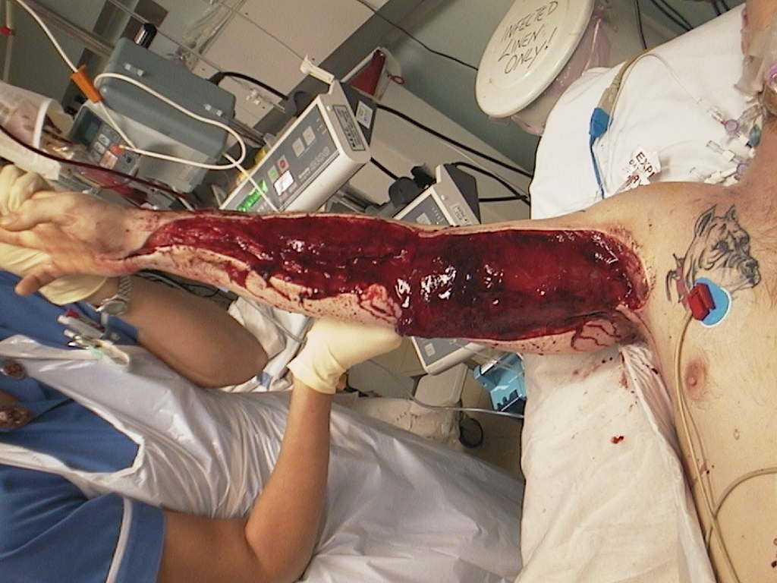

Slide 47
Summary
  The true costs of pressure ulcers remain very difficult to quantify
  Assessment depends on the clinician’s knowledge of anatomy and physiology
  Early recognition is essential in prevention
  Remember, it doesn’t always matter what you put on the pressure ulcer but what you put the pressure ulcer on!!!
Notes:
The true costs and extent of tissue damage caused by pressure, shear, or friction remain impossible to quantify.
Pressure ulcer assessment depends on an understanding of anatomy and physiology of the skin and underlying structures.
Repositioning and maintaining optimum activity levels are key objectives in reducing the risk of tissue damage.

Slide 48
Any questions ?
Michelle Greenwood
www.shelden-healthcare.co.uk

